Slide 1
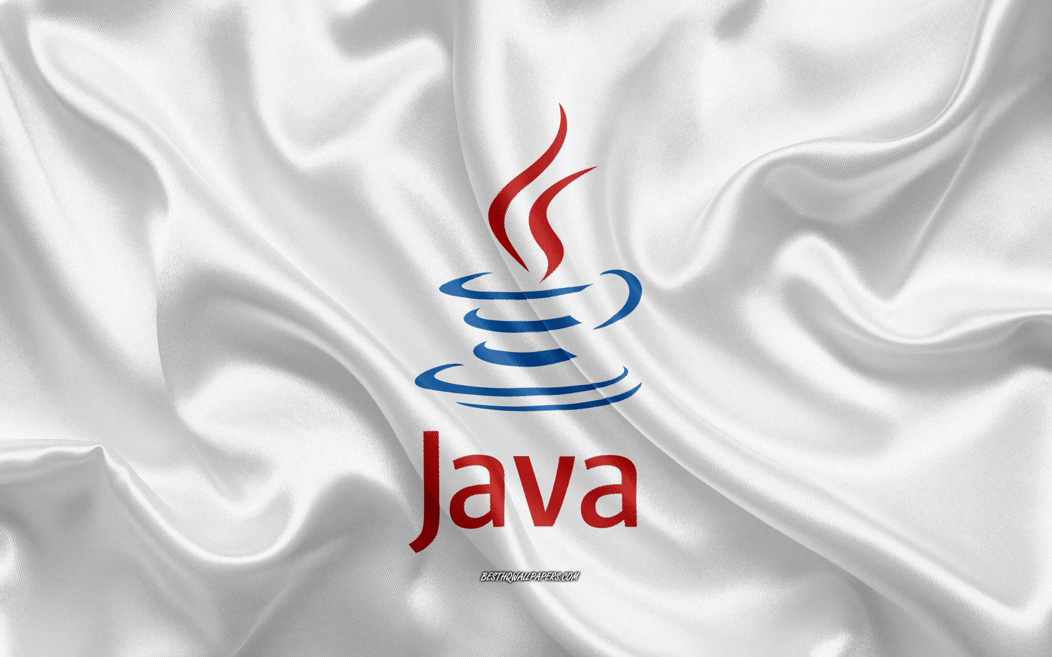
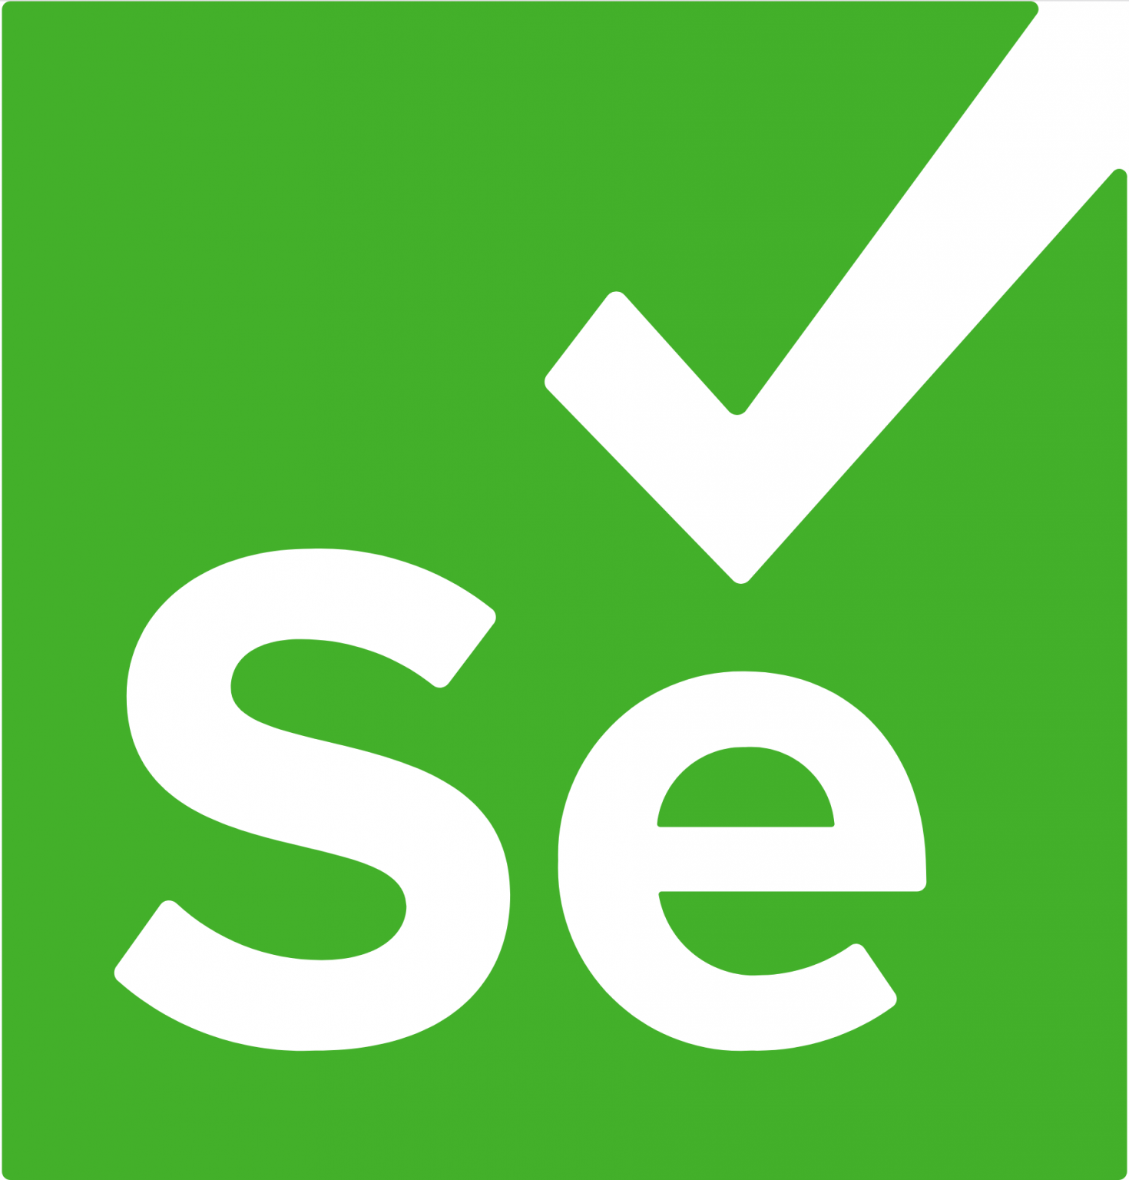








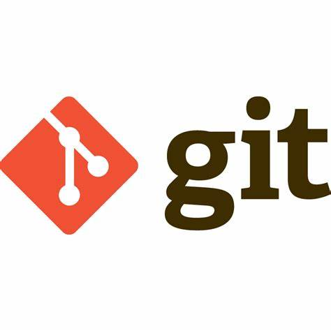



Playnium - Java : Test Automation Framework
Problem statement -> Modern automation frameworks must be able to execute legacy scripts designed on selenium , and also have capabilities to execute playwright with minimum code changes, using same wrapper methods, base classes & common utility classes. Multiple frameworks built on multiple tools is not sustainable. There should not be hard dependency on Tools. Tools should be used as plug & play, with majority of the framework code must be the same.
Test Layer
Logs
SOLID
DRY
KISS
Factory
Builder
Template
Execute Around
Strategy
Fluent interface
Command
Prototype
Proxy
Configuration
Framework Layer
Screenshot
Feature Files
Driver Layer
Reports
Test Data
POM classes
Utilities
Wrapper classes
Features
Supports both Selenium & Playwright
Multi Browser
Parallel/Serial execution
BDD & Non BDD test case flexibility
Excel, JSON, XML support for test data
UI & API test execution
User state management
Cookie, Token, oauth 2 authentication support
Customizable, open source
DB testing
Build
Deploy
Remote Execution
Distribute
source code

